Slide 1
TypeScript Basics
Hardeep Kaur Dhalla

Slide 2
Objectives
let and const
Template strings
Object types
Tuples
Enum types
Any type
Union types
Type aliases
Object and Array destructuring

Slide 3
How to update and re-declare a variable?
re-declare example
var greeter = “Hello";
var greeter = “Hi there";
Update example
var greeter = “Hello";
greeter = “Hi there";

Slide 4
let, const keywords
The let and const keyword were introduced in ES6 (2015).
let is now preferred for variable declaration.
Use const for constant values.
let and const cannot be Redeclared and have block scope.

Slide 5
Type Annotations on Variables
When you declare a variable using const, var, or let, you can optionally add a type annotation to explicitly specify the type of the variable:
let myName: string = "Alice";
let myName = "Alice";// works too

Slide 6
const
As a general rule, always declare a variable with const unless you know that the value will change.
It defines a constant reference to a value of an object or an array. You

Slide 7
const keyword
Const cannot be reassigned
const PI = 3.141592653589793; PI = 3.14; //error
Must be assigned a value while declaration
const PI;//error PI = 3.14159265359;

Slide 8
scope
Global
The scope is global when a var variable is declared outside a function.
Function
The scope is function when a var variable is declared inside a function.
Block
Variables defined with let and const have Block Scope.

Slide 9
How var works in global and function scope?
var tester = "hey hi"; // global scope
function newFunction() {
var hello = "hello";
console.log(tester); // prints “hey hi”
console.log(hello); // prints “hello”
}
console.log(tester); // prints “hey hi”
console.log(hello); // function scoped hello gives error: hello //is not defined
newFunction();

Slide 10
Problem with var
function printNum() {
var num = 2;
if(true) {
var num = 1;
console.log('inside block: ' + num); // prints 1
}
console.log(' outside block: ' + num); // prints 1
}
printNum();

Slide 11
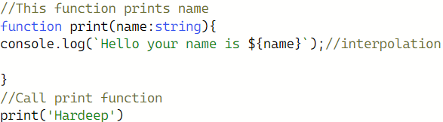
Template Strings
Use of backticks and ${}.

Slide 12
Working with objects
There are many ways to create objects in JavaScript.
Here in typescript, we can use object types to create type of an object.
To define an object type, we simply list its properties and their types.
{property name: property type;
property name: property type;}
You can also pass object types to functions.

Slide 13
Tuples
Tuples are fixed-length arrays and know exactly which types it contains at specific positions.
Introduced in typescript.
let tuple:[string, string, string];
tuple = ["UWSP", "2100 Main", "Stevens Point".toUpperCase()];
console.log(tuple[2])

Slide 14
Enum types
a fixed list of values.
Enums allow a developer to define a set of named constants.
TypeScript provides both numeric and string-based enums.
Number, string or mix and match enums.
enum Role {Employee, Manager, Admin};
console.log('Roles: ', Role[0], ',', Role[1], 'and', Role[2]);

Slide 15

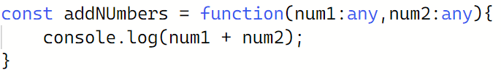
any type
Any means anything can be used as type. No type checking at all. Not recommended to use.
var something: any = 'as string’;
something = 1;
something = [1, 2, 3];
Examples:

Slide 16
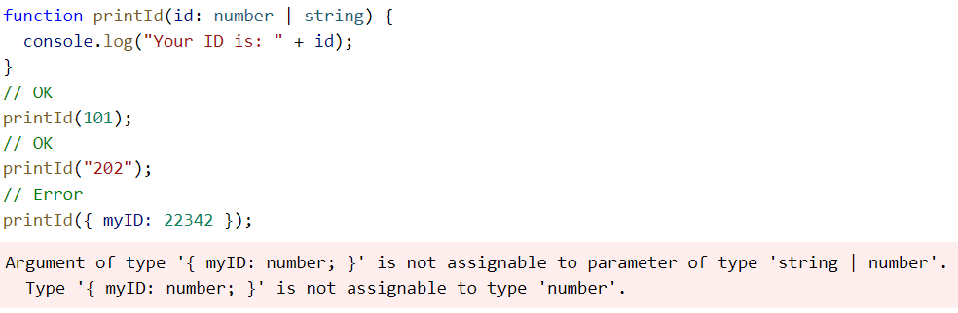
Union types
A union type is a type formed from two or more other types, representing values that may be any one of those types.

Slide 17
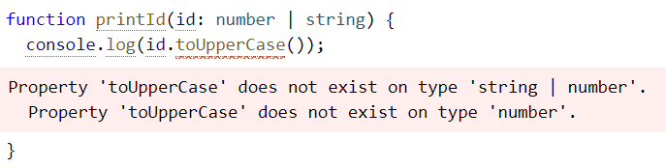
Union types
TypeScript will only allow an operation if it is valid for every member of the union.

Slide 18
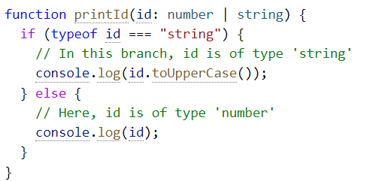
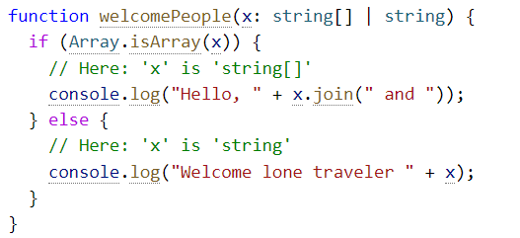
Narrowing
Narrowing occurs when TypeScript can deduce a more specific type for a value based on the structure of the code.
called type guards

Slide 19
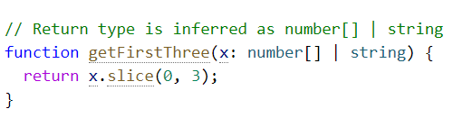
Union types
If every member in a union has a property in common, you can use that property without narrowing

Slide 20
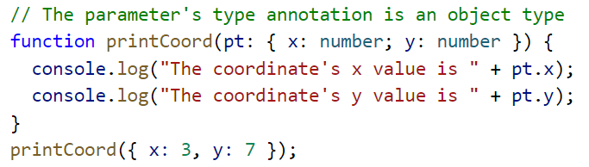
Type aliases
Type aliases can be used to create your own types.
Helps you write short and concise code.
Example:
type ID = number | string;

Slide 21
Arrays and Object destructing
Unpacking of array or object as constants or variables.
Does not modify original array or object.

Slide 22
For reference
https://www.typescriptlang.org/

